Slide 1
Object Oriented Analysis – Object Interaction Diagrams
By PJ Davies
With References to:
  UML Distilled by Martin Fowler. ISBN 0-201-65783-x
  Real-Time UML by BP Douglass. ISBN 0-201-65784-8
©Paul Davies 2020. Not to be copied, used, or revised without explicit written permission from the copyright owner. This lecture may contain animations and is best viewed as a slide show

Slide 2
The last lecture focused on the concept of structural modelling
This represented an attempt to identify
  The objects from which our system will be composed.
  The roles and responsibilities that each object will assume.
  The collaborations between objects, i.e. which objects communicate with others to implement a use-case.
  The relationships (arising from collaborations) between objects.
  The classes needed to implement those objects.
  The number of objects involved in any relationship (multiplicities).
Points 1, 2 and 3 above are captured on an object interaction diagram (either a sequence or a communication diagram).
Points 4, 5 and 6 are captured on a class diagram (see next week’s lecture).

Slide 3
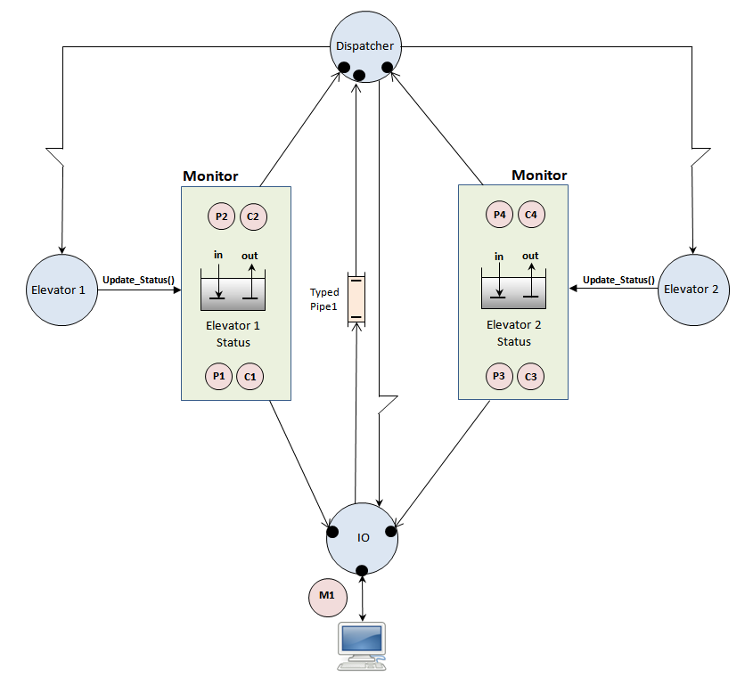
This picture shows the structure of an elevator simulation, i.e. the set of objects that collaborate to implement the use cases of an elevator
The connecting lines imply relationships between objects, i.e. some objects communicate with each other and others don't.
Question: Could you take this diagram and explain how a passenger arrives outside the elevator, makes an up/down request and is transported to a destination?
More to the point, as a developer, is there enough information in this diagram to write the complete simulation?
The answer is no –not at this stage.
Yes there is important information here, but how those objects work together to transport virtual passengers cannot be understood from this diagram.
It however could be explained using an object interaction diagram (today’s lecture). This is something an analyst or other developer might draw to supplement the above structural diagram.
Architecture of an Elevator Simulation

Slide 4
Modelling Object Interactions
Sequence
and
Communication
Diagrams

Slide 5
UML has two kinds of Object Interaction Diagram designed to capture how objects collaborate, through the process of message passing, as they attempt to implement the functionality of a use case.
These two types of diagram are
  Sequence Diagrams
  Communication Diagrams
  (previously called Collaboration diagrams in an earlier version of the UML)
The fact that two diagrams exist to record similar object interactions is historical and dates back to the time when there was no UML, only 3 different competing standards with their own ideas on modelling.
Developers who had grown up using one type of diagram were reluctant to dispense with it and adopt another, without good reason, some developer could also see merit in both types of diagram (each has its own strengths) thus both diagram types survived the unification of the modelling “wars” and became integrated into the UML.

Slide 6
The Use of Interaction Diagrams in Modelling Use-Cases
Generally speaking, we draw at least one of these two diagram types to document each use-case.
Hierarchical Interaction Diagrams for Complex Modelling
Where use case is complex, we may choose to capture it using more than one interaction diagram, perhaps using a hierarchy with each diagram exposing more and more detail as we descend the hierarchy.
If the use case has many interesting and non-trivial scenarios, we might draw an interaction diagram for each – it depends on the situation.
Either way, an interaction diagram (sequence or communication) captures the behaviour of a use-case as a set of collaborating objects as they communicate through a process of message passing.

Slide 7
Sequence Diagrams Emphasise Time Driven Behaviour
Sequence diagrams document message passing as a function of time, i.e. they emphasise the order in which messages propagate between objects. They are particularly useful in real-time systems as timing information can be annotated onto them.
Sequence diagrams lay out the collaborating objects in a horizontal line but in doing so, the systems architecture or structure is less obvious to the reader than a communication diagram. i.e. it is harder to identify at first glance which objects collaborate with others (as an example see next slide)
Good video on drawing sequence diagrams in Visual Paradigm https://www.youtube.com/watch?v=18_kVlQMavE

Slide 8
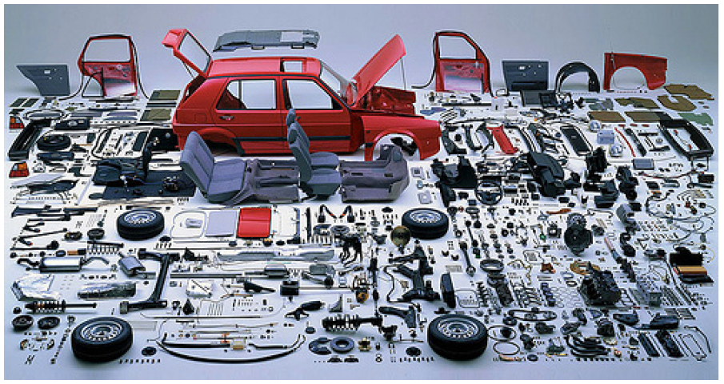
A sequence diagram is like laying out in a line, all the objects that make up a car. The structure and co-operation between the objects is difficult to see.
Relationships between objects can be uncovered from a sequence diagram but it is easier to identify these in a communication diagram.

Slide 9
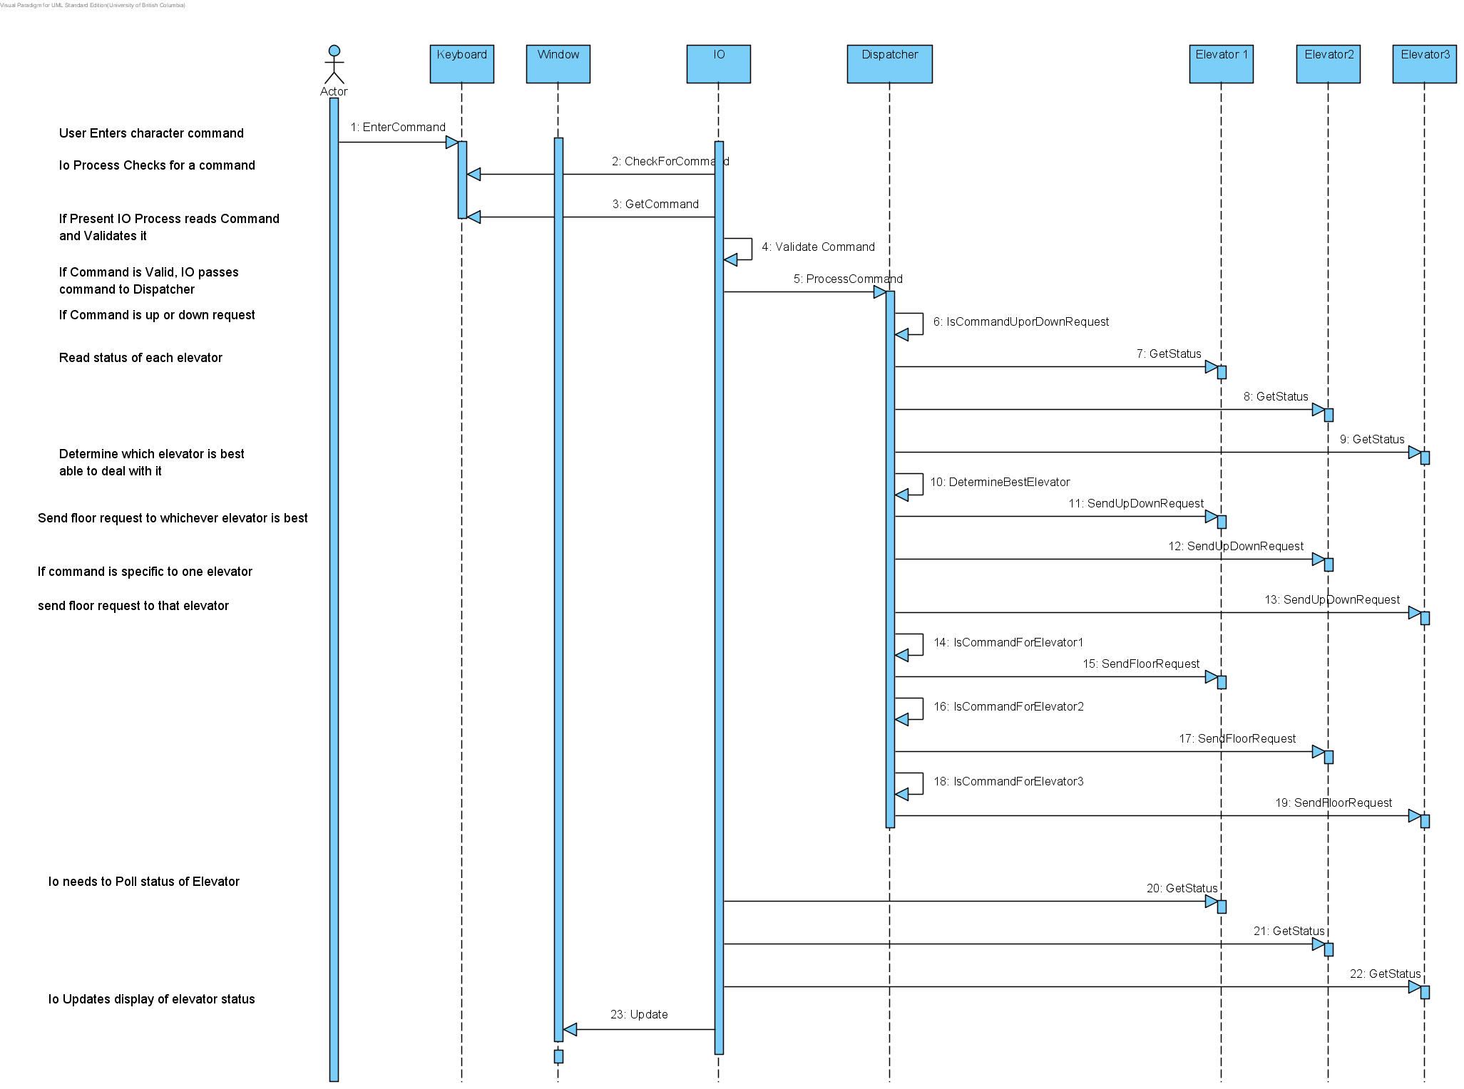
Example Sequence Diagram

Slide 10
Communication Diagrams Emphasise Structure and Collaborations
One particularly useful/nice feature of communication diagrams is that due to way objects are laid out in the diagram, it is easier to identify object relationships i.e. which objects collaborate.
However, it is not so easy to see the time-dependent order in which messages propagate between objects (that’s why Sequence Diagrams exist).
The architecture you were given in your 1st assignment was similar to a communication diagram, (actually it was an object diagram capturing a “snapshot” of the objects that exist in a system at a point in time) but no messages were shown so it was not a complete communication diagram.

Slide 11
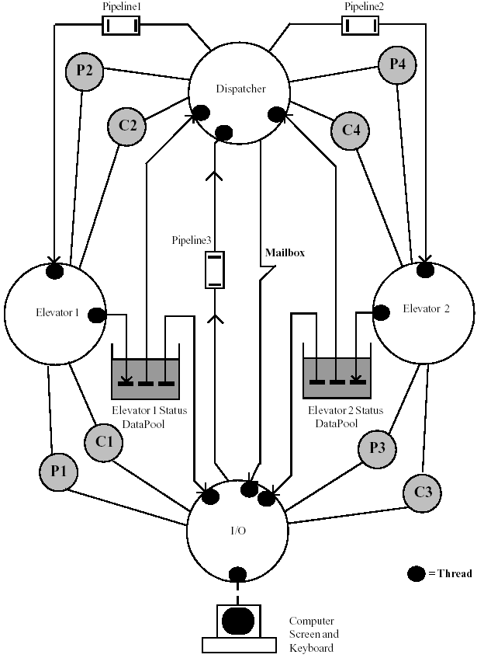
1: Read()
By adding messages to an Object diagram, we end up with a Communication diagram.
Such a diagram makes it easy to identify which objects interact with others (lines connecting objects due to need to send messages) while also conveying a sense of structure and architecture.
Here only the messages related to elevator 2 are shown for simplicity
Whilst I like communication diagrams, sequence diagrams are ultimately more powerful capturing : concurrency, time and decision making (if-then-else) and different types of messages.
2: Wait()
6: Signal()
4: Update()
3: Wait()
5: Signal()

Slide 12
Introduction to Sequence Diagrams
Because a sequence diagram models the realisation of a use-case as a set of collaborating objects, it naturally follows that a sequence diagram contains:
  At least one actor representing the user initiating the use-case.
  A set of objects which were identified using the techniques of lecture 22a , e.g. nouns analysis etc.
  A set of messages propagating between those objects which might also include message arguments and returned data (e.g. verbs analysis).
Good overview here https://www.smartdraw.com/sequence-diagram/

Slide 13
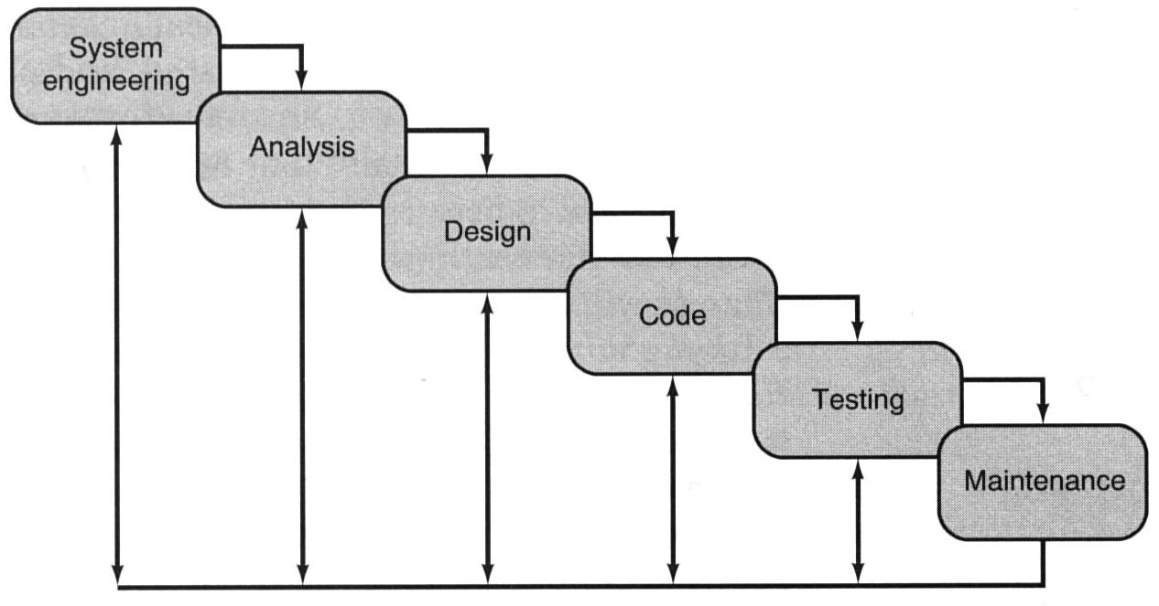
Analysis vs. Design based Sequence Diagrams
Sequence and/or communication diagrams are generally drawn in both the analysis and design phases of the software lifecycle model (and during sprints if an agile approach is taken and it is felt they would be helpful).
Analysis
Design

Slide 14
Analysis Driven Sequence Diagrams
Sequence diagrams drawn during analysis focus on what needs to happen, and probably show how something is done right now.
It would likely show the real people performing the task in the current workplace.
Such a diagram is very useful to show to the customer and is often drawn with the minimum of technical/implementation details and generally shows information that the customer could relate to e.g. employee Fred in the workshop carrying out task X or Doris at the supermarket checkout etc. or perhaps a proposal for how an automated system might work in the future
They are useful during analysis for capturing and understanding how the company does things now i.e. its operation and business logic (e.g. raising an invoice after shipping etc), before we provide a software solution.

Slide 15
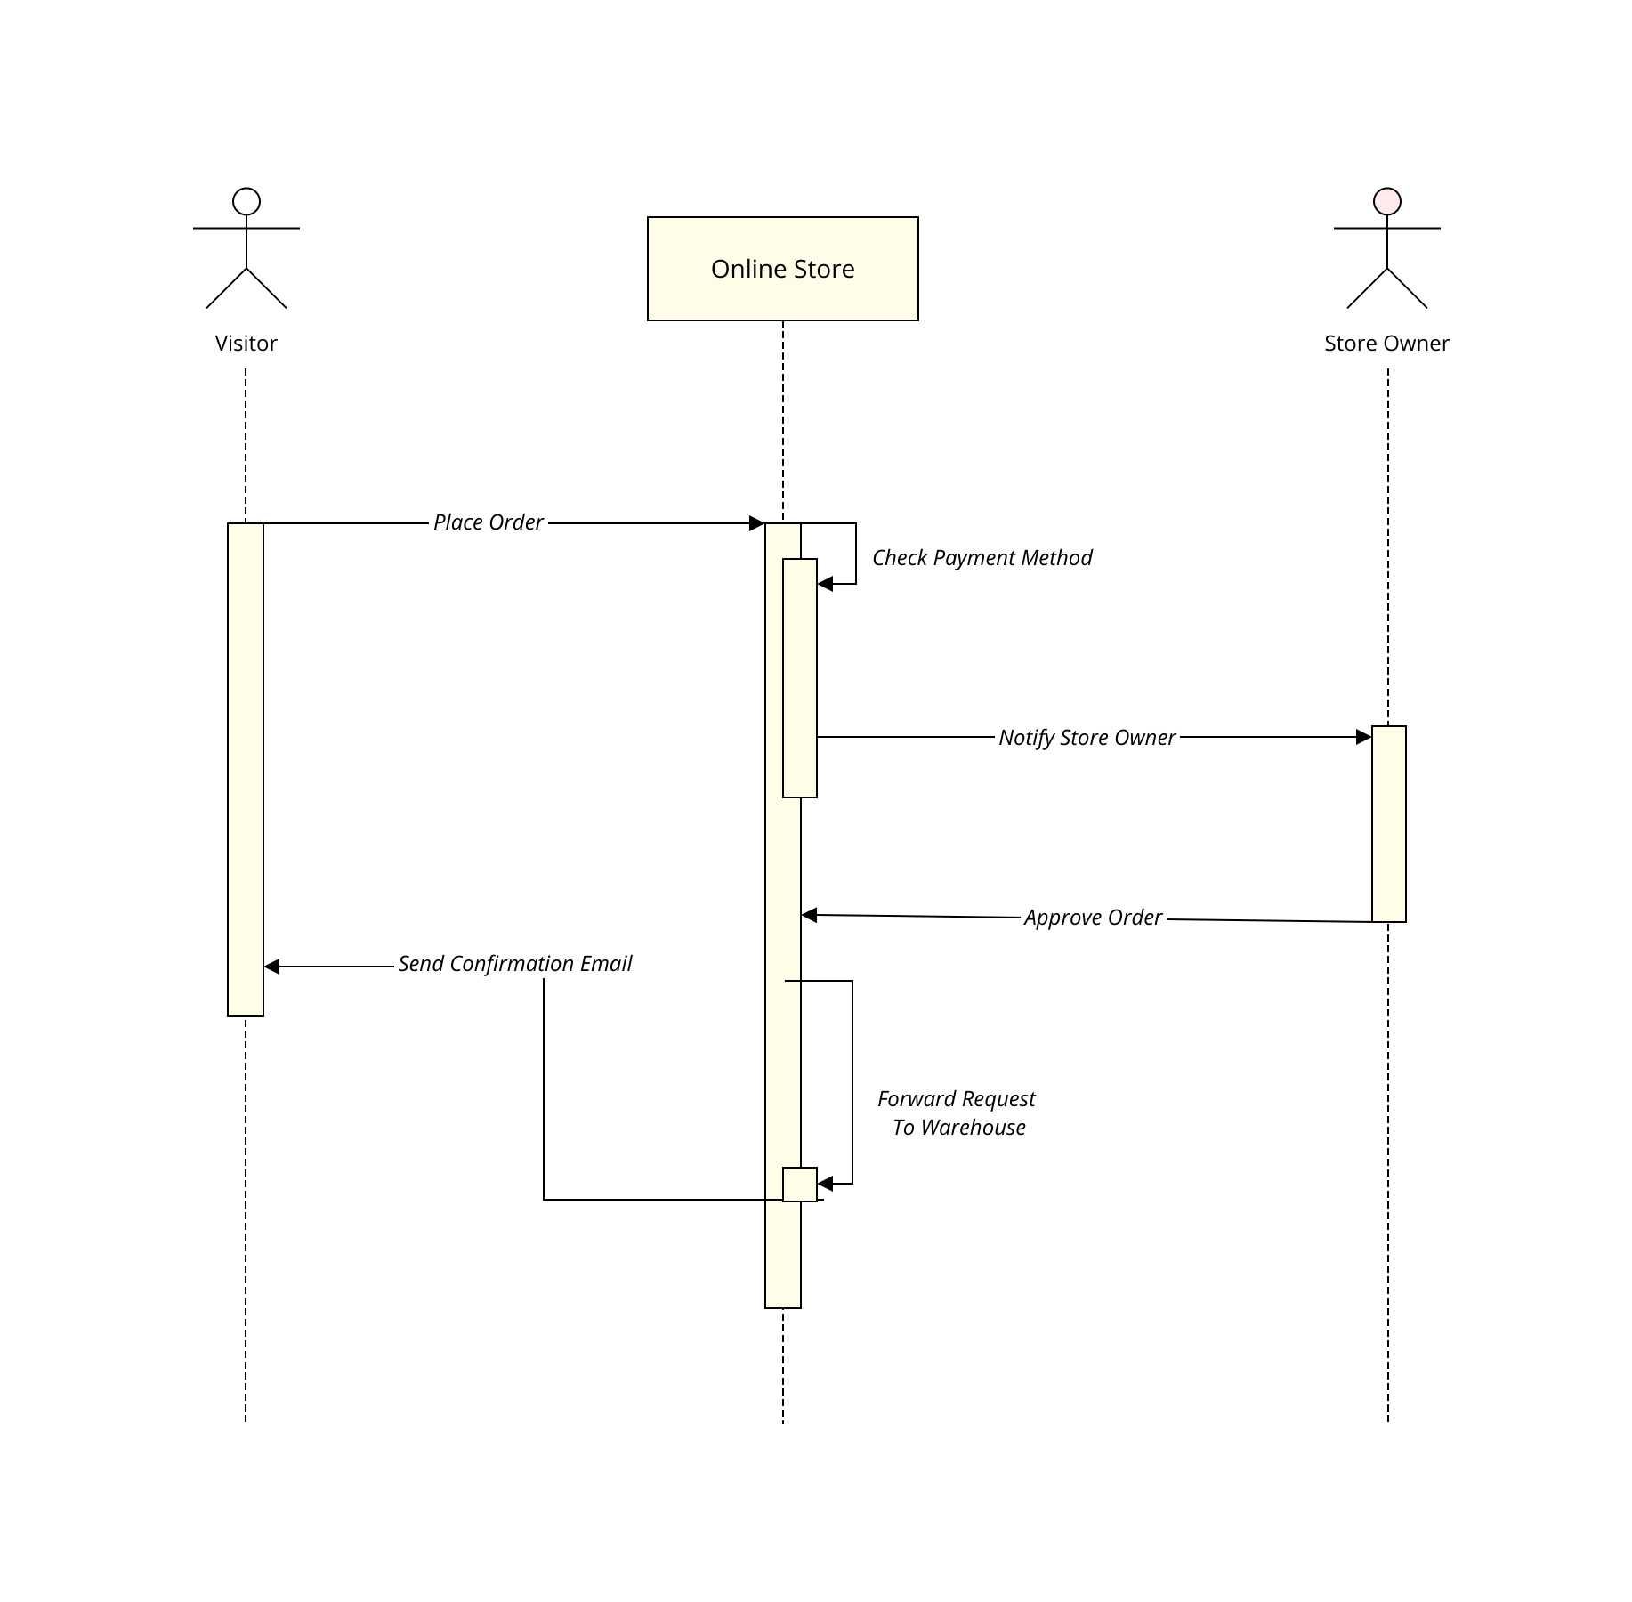
Example analysis model sequence diagram shows minimal technical details
Source: https://moqups.com/templates/diagrams-flowcharts/uml-diagrams/sequence-diagram/

Slide 16
Design Driven Sequence Diagrams
During Design, sequence and communication diagrams are developed to model the implementation of the software and system as it will be built.
Consequently things like Paper Form T14A currently being used by the customer might be replaced by a GUI object.
A Librarian might be replaced by a Database and Barcode scanner.
New messages will be draw to reflect these new objects and then given to the developers to build.
This second design driven Sequence Diagram might also show technical and implementation details such as Threads, semaphores, data bases, bar code readers, user screens etc.
The analysis driven sequence diagram is thus something you might develop with the customer to increase your understanding of their organisation and how things work now.
A design driven sequence diagram translates this into software objects that achieve the same thing and is useful for coders and software developers.

Slide 17
Good example to think about:
Imagine ATMs had not been invented.
Draw an (Analysis phase) sequence diagram to capture the interactions involved when a customer withdraws money from their account showing how things are done now, (i.e. an analysis model) involving a cashier at the bank, paperwork, forms, receipts etc.
Now imagine you are trying to replace that cashier with an ATM – how would the (design based) sequence diagram look now?
Take a look here (again) for one possible solution https://www.youtube.com/watch?v=18_kVlQMavE
Another good example tutorial on sequence diagrams
https://creately.com/blog/diagrams/sequence-diagram-tutorial/

Slide 18
An Analysis Model Sequence Diagram Capturing my Dad
Driving a Car

Slide 19
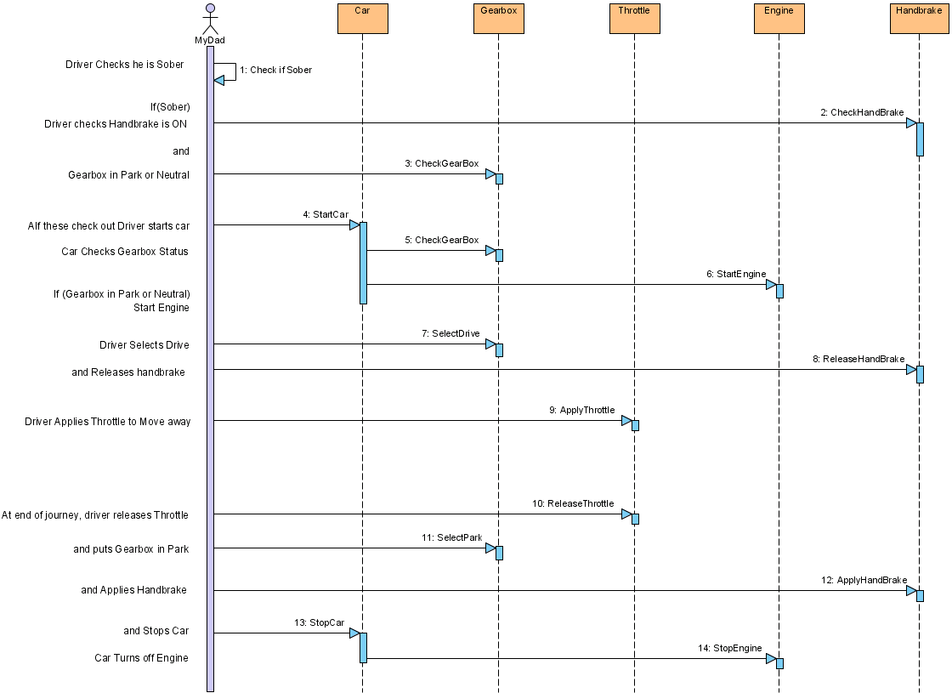
Actor initiates 1st message
Object lifeline showing Objects involved in Interaction and their ‘life’ duration
Simple “Analysis Model” Sequence Diagram Describing the Driving of a Car
Object sending message to ‘self’
User sending message to Object
Message 6 sent from one object to another in response to message 4
Message
4 may lead to 5 & 6
'Bar' shows the duration for which a thread executes within the object (advanced modelling technique)
Note ALL messages contain VERBS in their name as they ask an object to do something, i.e. carry out one of its responsibilities
Comments to help reader interpret diagram/message
Time

Slide 20
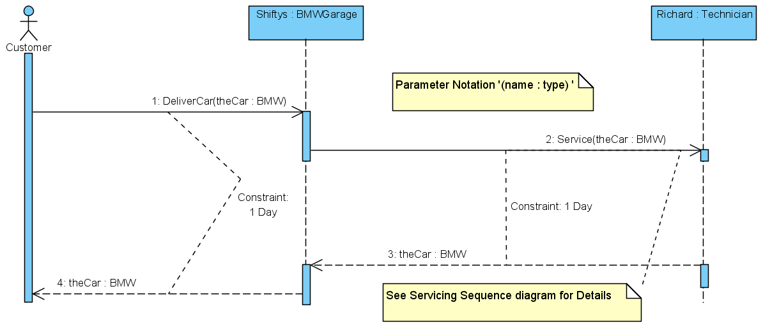
Object/Class Identification and Message Arguments
Objects on a sequence diagram may include their class name if this is known. Usually this is only relevant during design, not analysis.
Messages may also have arguments and a return type associated with them allowing data (objects) to be passed and returned with a message.
Object name = Shiftys
Class name = BMWGarage
Richard is an instance (object) of a Technician (class)
Message passes “theCar” as a parameter which is an instance of a BMW class
Message returns “theCar” which is an instance of a BMW class

Slide 21
Problem to think about outside the class
Draw an ‘analysis model’ sequence diagram to show how a customer
  Withdraws money from an Bank
  Borrows a book from a Library
Show “real world” objects involved and the messages.
Remember that at this stage (analysis not design) we are modelling the real world concepts only, i.e. the physical things and people that make it happen, capturing rules and logic, not the software objects etc.
Implementation details such datapools, pipelines, mutexes, GUI's databases etc. will not be shown at this stage (the customer is certainly not interested in them because they are design based, implementation details).
Now refine the diagram to show Design aspects i.e. add the implementation objects (databases, GUI's etc.) and update the messages accordingly.

Slide 22
Drawing an ATM
Sequence Diagram
for the Use Case
Withdraw Cash

Slide 23
ATM Use Case description for Withdraw cash
The user inserts their ID card into the Card Reader.
The system reads the magnetic strip from the card to identify user & account.
The system contacts the banks central computer to request the PIN number for the card and their account details.
The system prompts the user to enter their PIN.
The user enters their PIN at the keypad.
If PIN is verified and the user is prompted for the amount of the withdrawal. If not, the card is returned to the user with an appropriate failed identification message.
The system prompts for the amount of the cash withdrawal.
The user enters the amount of the cash withdrawal at keyboard.
The system checks with the banks central computer to ensure that the user has sufficient funds to make the cash withdrawal.
If there are sufficient funds, the cash is dispensed and the customer’s account at the Bank Central Computer is debited accordingly, otherwise an appropriate “insufficient funds” message is displayed
The card is returned to the user and a receipt is printed.
End
Step 1: What candidate objects can you identify from this use-case (refer to lecture 22a)?

Slide 24
Sequence Diagram for Getting Money from an ATM
Identify the Objects
Identify the messages as actions (message name must contain a verb)

Slide 25
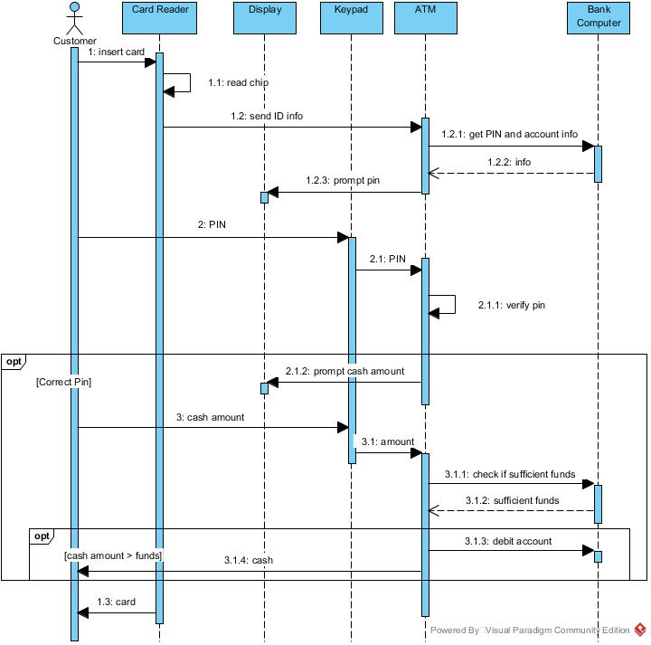
Example Sequence Diagram for ATM Use Case - Withdraw Cash

Slide 26
Drawing a Library
Sequence Diagram
for the Use Case
Borrow Book

Slide 27
Use-Case: Borrow Book
The member identifies himself or herself to the librarian using their membership card.
The member presents one or more books to the Librarian.
The Librarian checks the books to make sure they can be loaned.
The Librarian checks the membership card to make sure it is valid.
The Librarian looks up the member’s record in his/her card indexing system and checks that the number of loaned books will be less than 6, (the maximum that can be loaned at any time to a library member).
If acceptable, each book is then stamped with the appropriate return date (2 weeks from today).
Each book has its identifying card removed from the inside cover.
The Librarian updates the member’s loan details by placing the identifying cards into that members record maintained by the library.
End
Step 1: What candidate objects can you identify from this use-case (refer to lecture 22a)?

Slide 28
Sequence Diagram for Borrowing a Book from a Library
Identify the Objects (nouns)
Identify the messages as actions (message name must contain a verb)
Homework: See if you could draw one

Slide 29
Capturing Decisions and Iterations on a Sequence Diagram
How do we show things like repetition and decisions on a sequence diagram?
The first thing to note is that a sequence diagram is not a substitute for a flowchart so don’t try to model every tiny little ‘do-while’ and ‘if-then-else’ type condition.
Only attempt to model things that are important from the users perspective and capture the essence of the systems behaviour (e.g. scenarios). Leave detailed implementation decisions to the design/coding phase.
For example, when capturing the process of making a cup of instant coffee, you can assume that:-
  The kettle is plugged into the outlet
  electricity is available,
  milk is in the fridge,
  sugar in the cupboard, etc.
You only want to capture the essence of how these objects interact to make the coffee, not capture a million “what if there’s a power outage ” type of details.

Slide 30
Assuming this is understood, there may be some occasions where modelling repetition and decisions is useful, but only if they impact the user during their interaction with the system or are important for capturing important business decisions for the customer.
Some of the available techniques to capture this are described below:-
  Text or Pseudo code annotated onto the diagram (usually in the left hand field) as we saw previously when driving a car.
  Placing ‘stick-it’ notes over the diagram to point out key decisions or repetition (use an ‘anchor’ to attach it to a message).
  Enclosing sequences/repetition within a frame and showing the circumstances under which they will be executed.

Slide 31
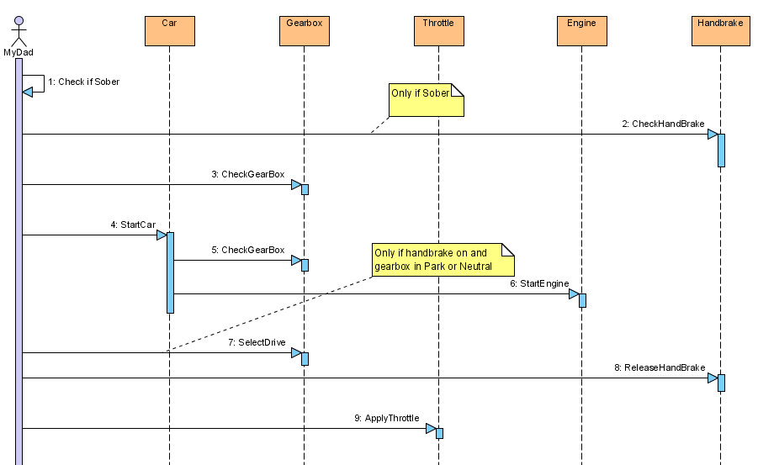
Example 1: Using “Stick-it” notes plus a line to anchor it to a message

Slide 32
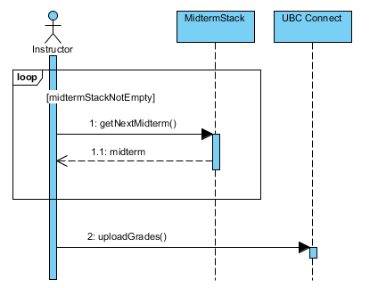
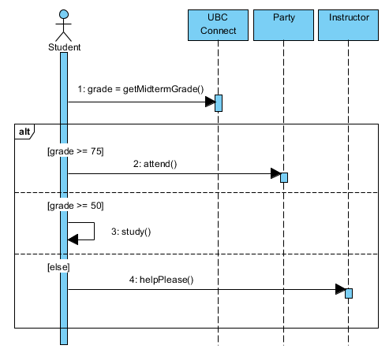
Example 2: Using Frames to Show Repetition and Decision Making
Instructor grading a stack of Mid-terms
Student response after getting their Mid-term Grades

Slide 33
Some Common Frame Operator Meaning
Homework Exercise
Opt | Optional fragment that models simple if (Condition) is true – do something
Alt | Alternative fragment for mutually exclusive logic based on if-else type decision. (see example in last sheet)
Loop | Loop fragment: A sequence of messages that repeats while some Condition is true. (Note: Can also be written as loop(n) to indicate looping n times)
Par | Two or more sequences that execute in parallel.
Region | Critical region. A sequence of statements that can only be executed by one thread at a time, the implication is that the designer will have to implement some form of mutual exclusion (i.e. a mutex with wait and signal) to protect the code.

Slide 34
Capturing Active Objects and Different Message Types on Sequence Diagrams

Slide 35
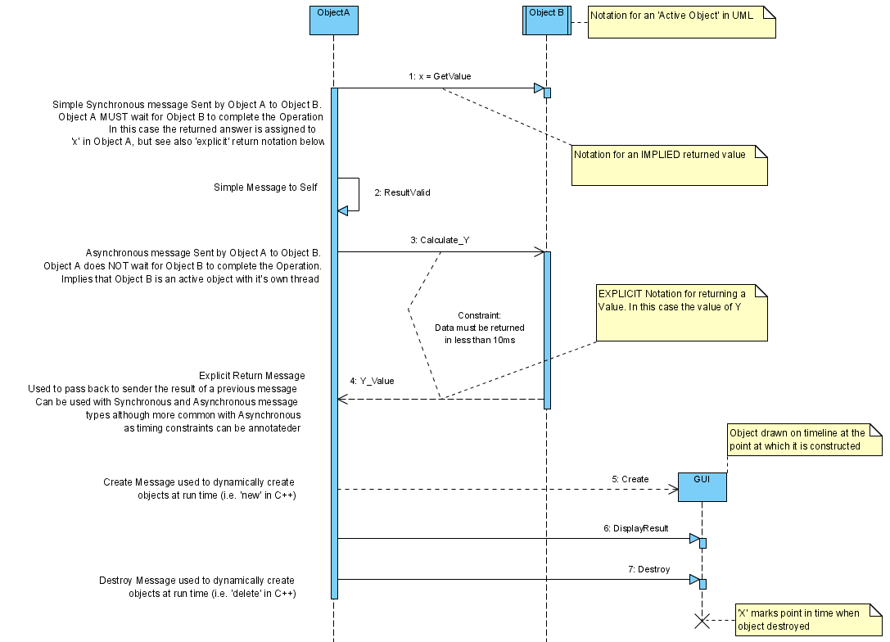
Active Object Notation
UML Message Types, returned values and Object Life
Note notation for an active object. This implies an object which has a thread running within it.
It could be a C++ active object (as we saw in Part A of this course) or perhaps a process or even a full application perhaps running on a remote machine

Slide 36
Different Message Types
UML Message Types, returned values and Object Life
Note arrow type. Right click in VP to set the type of message
Synchronous message 'GetValue' sent by Object A to Object B.
Synchronous messages means that the sender must wait for the receiver to complete the actions implied by the message and return (with or without any result).
These are the most common message types as they map to sender invoking a function within the receiving and waiting for receiver to return.
In the example shown the implied returned answer is assigned to the variable ‘x’ within Object A, but see also the ‘explicit’ return notation later.

Slide 37
Different Message Types
UML Message Types, returned values and Object Life
Synchronous Message sent by an object to itself. That is, ObjectA sends the message 'ResultValid' to itself.
Ultimately this means that some function running in ObjectA will invoke a second function from within ObjectA to implement the message 'ResultValid'.

Slide 38
Different Message Types
UML Message Types, returned values and Object Life
Asynchronous message: Object A sends message 'Calculate_Y' to Object B.
Semantics of an asynchronous message mean that sender does NOT have to wait for receiver to complete the Operation.
This Implies that Object B is ‘active’ (e.g. has it’s own thread) so that Object A and B can continue to execute in parallel.
Could be used to model idea that Object B could be running on a different machine and the message could be sent over a network e.g. the internet using remote procedure calls (RPC).
Note arrow type. Right click in VP to set the type of message

Slide 39
Different Message Types
UML Message Types, returned values and Object Life
Explicit return Message. Used to show receiver passing back the results of a message to the sender.
Can be used with Synchronous and Asynchronous message types although more common with Asynchronous as timing constraints can optionally be annotated if the return is made explicit.
If the data is returned as a result of an Asynchronous message (as shown here), then this implies that during design/implementation the returned data may come back at any time as the sender would not be obliged to sit there waiting for it. This in turn could imply that the data is returned via something like a Pipeline, Data Pool, Internet etc.
Note arrow type. Right click in VP to set the type of message

Slide 40
Different Message Types
UML Message Types, returned values and Object Life
Note arrow type. Right click in VP to set the type of message
Create Notation. Used to model concept of Dynamic creation of objects at run time (e.g. using operator ‘new’ in C++). Note position of object drawn some way down the time line of this diagram to reflect point/time of creation.

Slide 41
Different Message Types
UML Message Types, returned values and Object Life
Destroy Message. Used to model concept of objects being destroyed at run time (e.g. operator ‘delete’ in C++)
'X' on object timeline shows end of objects life, i.e. point where object ceases to exist.

Slide 42
Identifying Object Relationships
and
Multiplicities from a Sequence Diagram

Slide 43
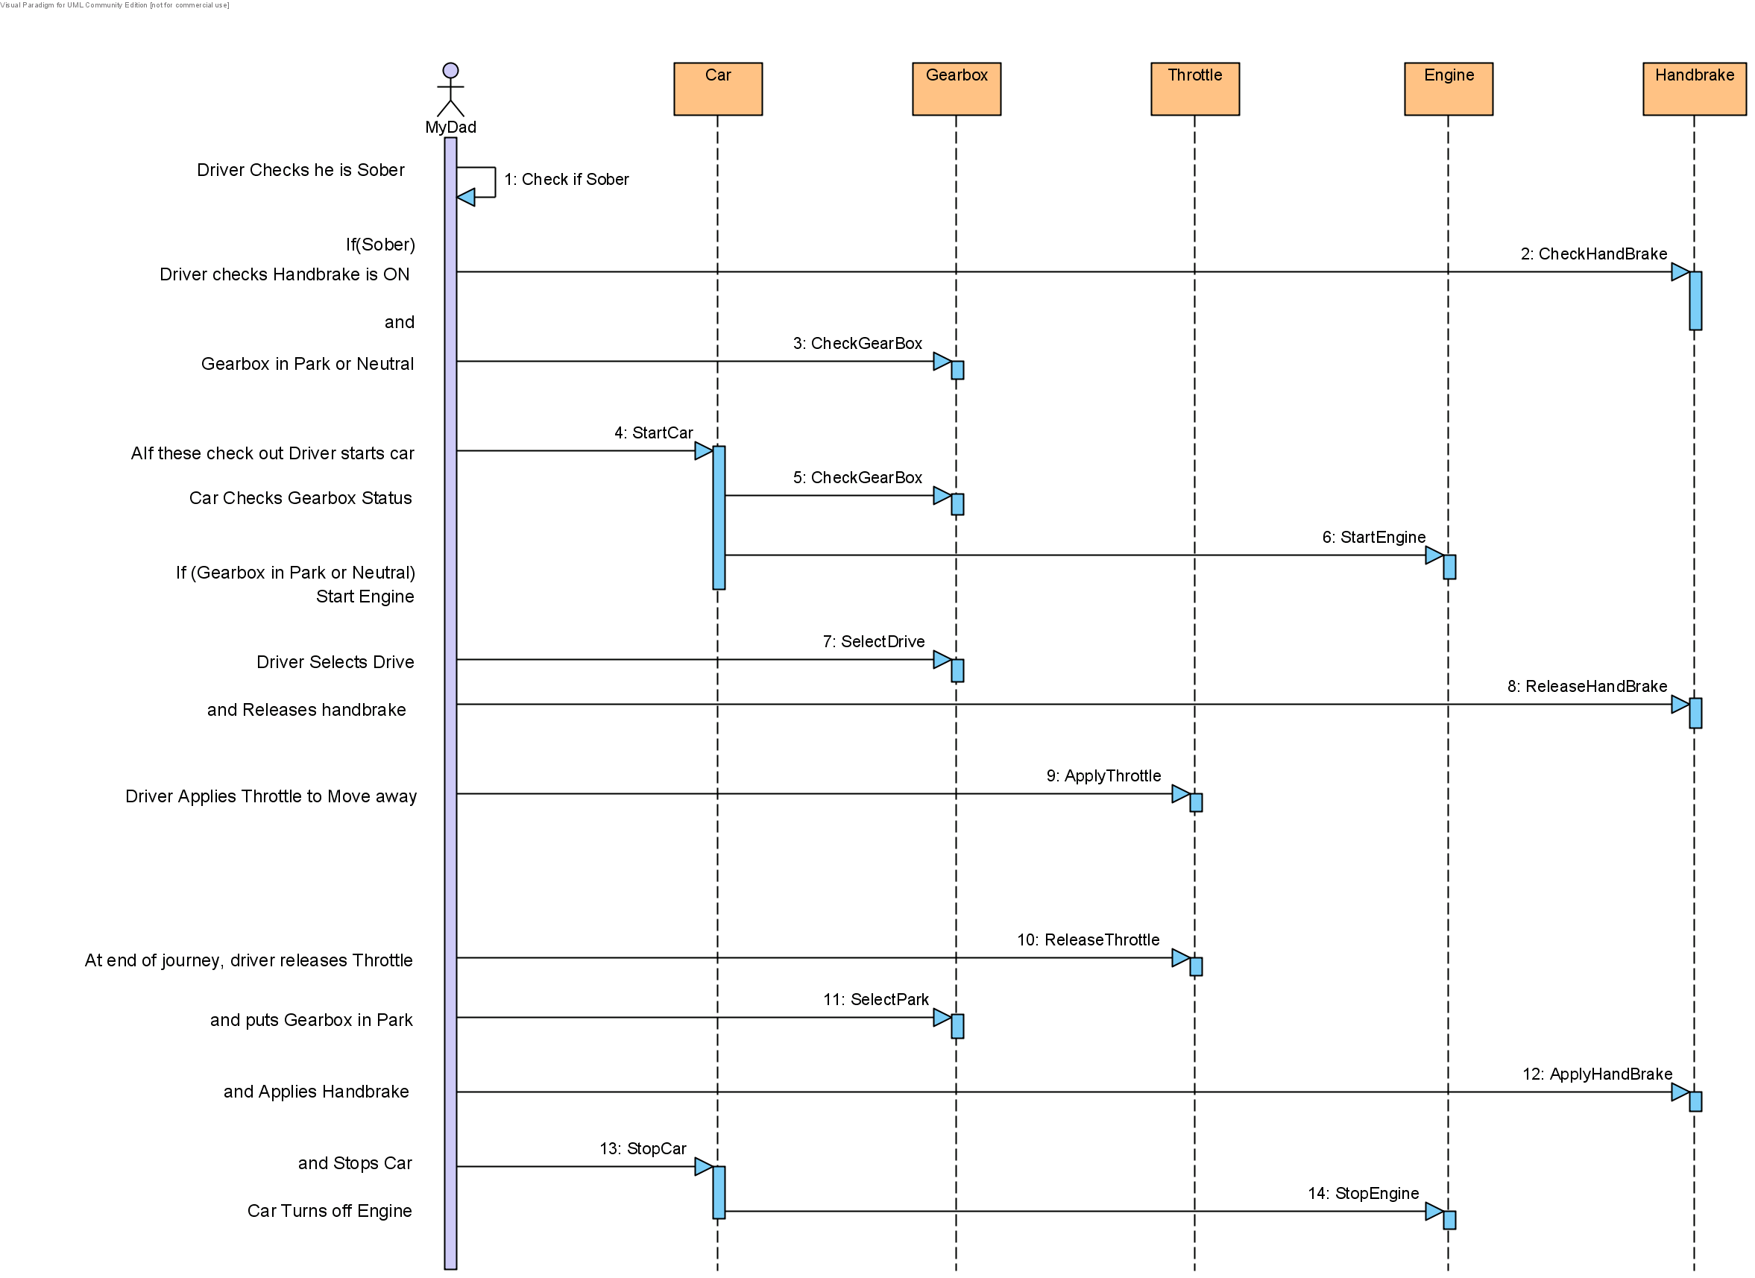
When a message is sent from one object to another there is an implied relationship between those objects. The number of objects that send and receive messages also tells us something about their multiplicities.
From the diagram below we see that there is a 1:1 multiplicity between a Car and an Engine object, because the car only sends messages to one single engine and the engine only receives messages from one single car i.e. there are no other engine or car objects shown here.
No Relationship between Engine and Handbrake since neither sends messages to each other
Message implies a relationship between Car and Gearbox and also between Car and Engine. The Multiplicity is 1:1 in both cases

Slide 44
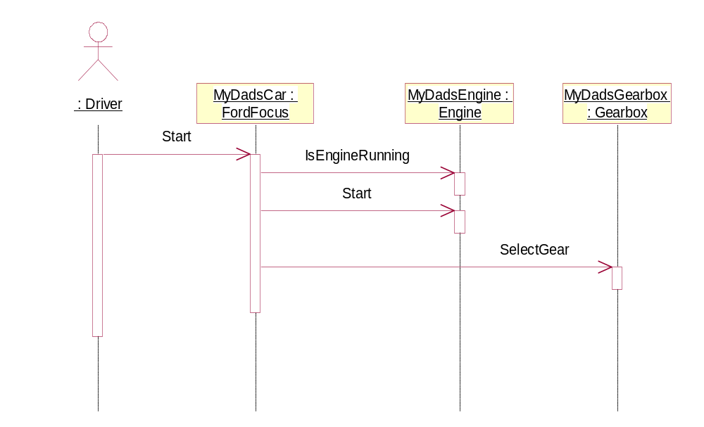
Mapping Messages, Relationships and Multiplicities into Code
Messaging is typically implemented using pointers in the sending object.
Those pointers will need to be initialised at run time, either during a constructor call or through the use of a function called later to point the sending object to its receiver object.
A Message can then be sent using the pointer to invoke a member function in the receiving object.
The code fragment opposite shows how those relationships and messages could be realised in C++.
Identifying multiplicities is important as it tells us how many pointers we need.
Thus a Ford Focus needs a single ‘Engine’ pointer so that it may send messages to the one engine and a second ‘Gearbox’ pointer to send messages to the one gearbox.
class FordFocus
{
Engine *MyDadsEngine; // must be initialised later
Gearbox *MyDadsGearbox; // has be initialised later
. . .
. . .
void Start() // when Car receives ‘start’ message
{
if( MyDadsEngine -> IsRunning() == false) {
MyDadsEngine -> Start() ; // send ‘start’ message to engine
MyDadsGearbox -> SelectGear() ; // send ‘select gear’ message
}
}
}
class FordFocus
{
Engine *MyDadsEngine; // has to be initialised
Gearbox *MyDadsGearbox; // has to be initialised
. . .
. . .
void Start() // when Car receives ‘start’
{
if(MyDadsEngine->IsRunning() == false) {
MyDadsEngine->Start() ; // send start to engine
MyDadsGearbox->SelectGear() ; // select gear in gearbox
}
}
}

Slide 45
Example Case-study
Modelling the actions a Garage and a Technician servicing a Car

Slide 46
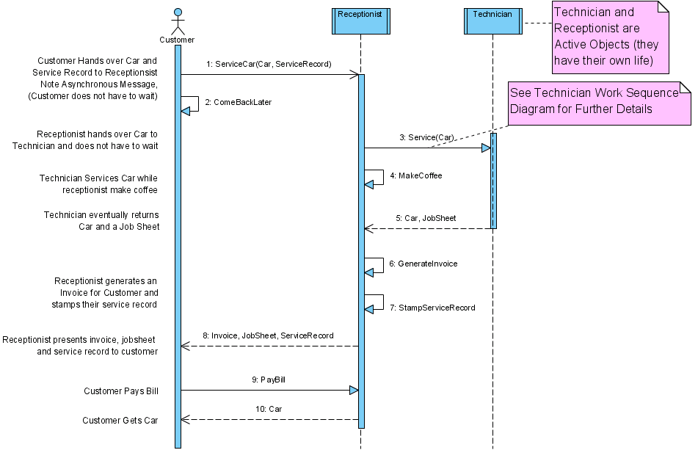
Asynchronous Message. Note two objects or pieces of data are passed. The ‘Car’ and ‘Service Record’. Note also that it’s OK to show simple data being exchanged between user and system, there doesn’t have to be a “verb” associated with a message asking the user to do something
Car, Service Record
The complex actions associated with processing this message i.e. Service(Car) is captured on another sequence diagram (see next page)
Note multiplicities. There is exactly one receptionist talking to one technician and one technician receiving messages from exactly one receptionist i.e. the multiplicities are 1-to-1.
payment
Hierarchical Sequence Diagrams showing the servicing of a car

Slide 47
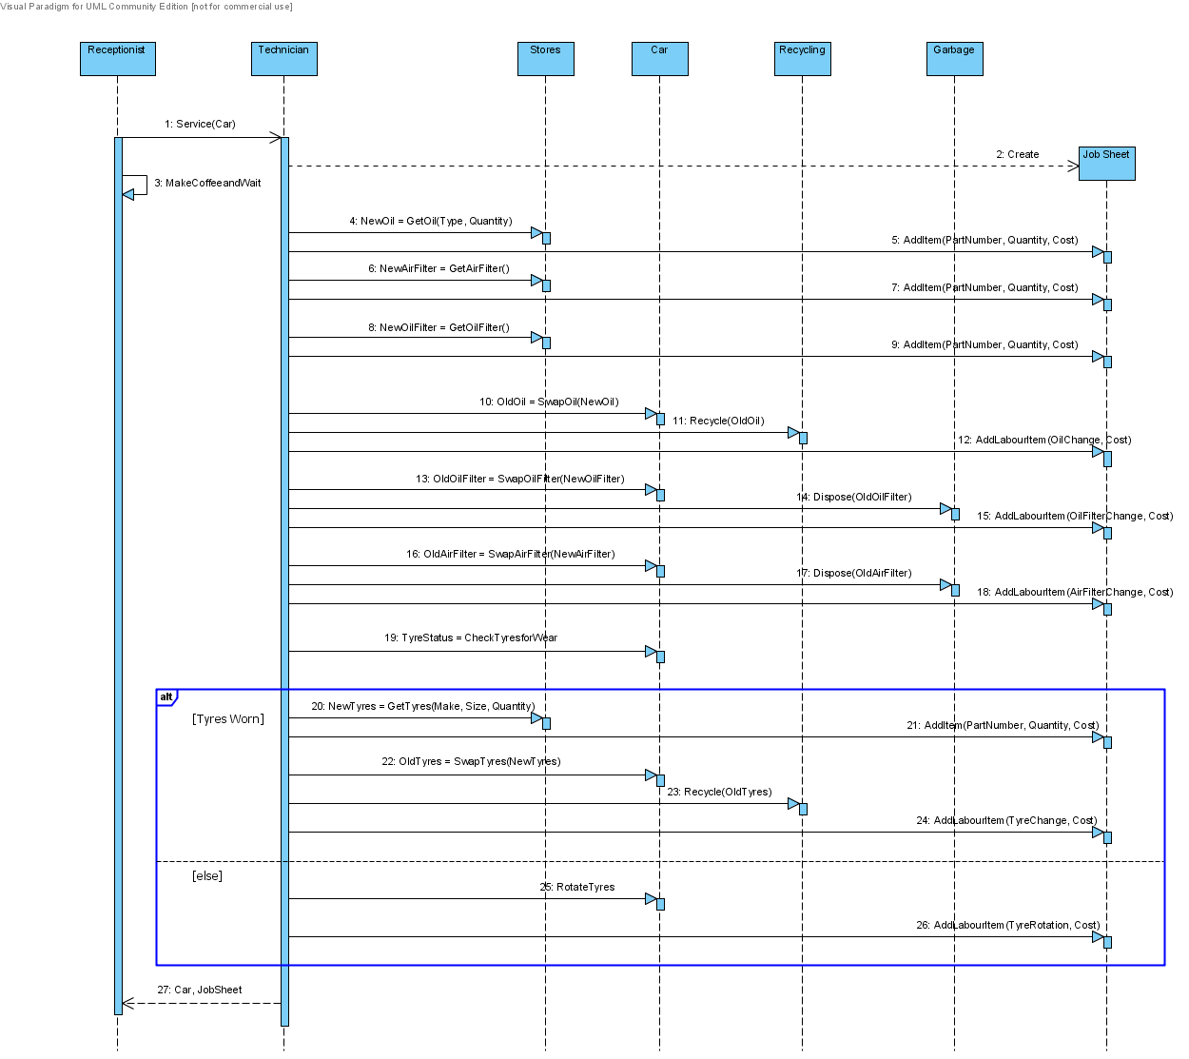
SD Frame
Gate
Note Oil, Oil Filter etc. are implied objects (but could be simple ints, or structs if no messages are shown being sent to them, i.e. if they are just passed as parameters)
Note message and returned data correspond with higher level sequence diagram
Technicians Work Sequence Diagram, i.e. an expansion of what happens in response to the ‘ServiceCar()' message

Slide 48
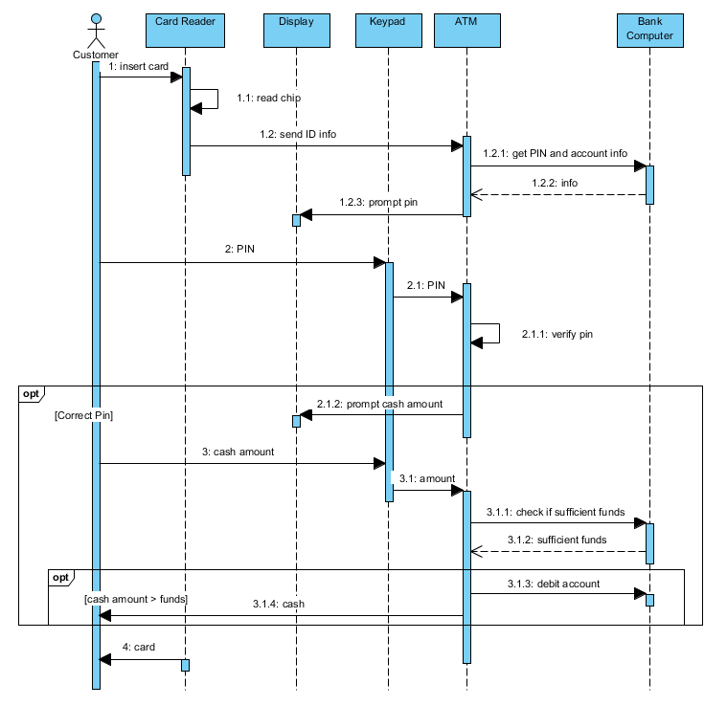
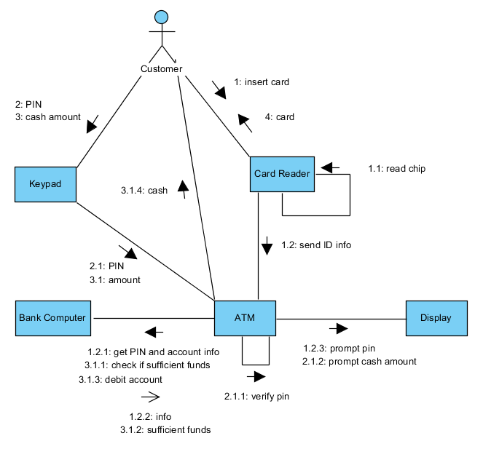
Communication Diagrams
Previously called collaboration diagrams (don’t get confused by old website posts)
An object diagrams with messages, a pictorial version of a sequence diagram. Less powerful.
Numbered messages go on the interaction arrows. Time and Frames not shown
Image below shows SD and CD diagrams for an ATM
https://www.visual-paradigm.com/guide/uml-unified-modeling-language/what-is-communication-diagram/

